Slide 1
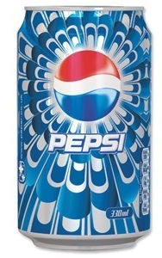
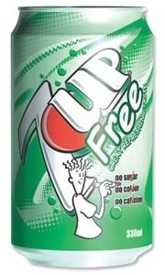
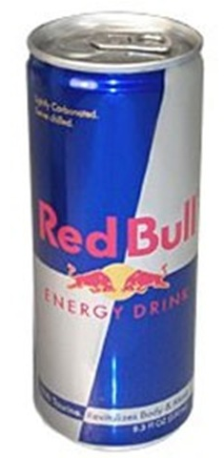
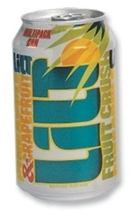
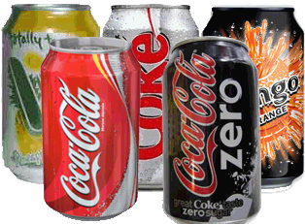
Drinks Upper – Lower Bounds

Slide 2
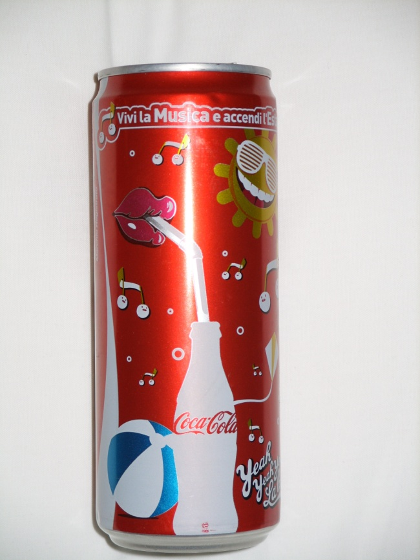
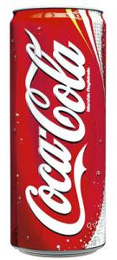
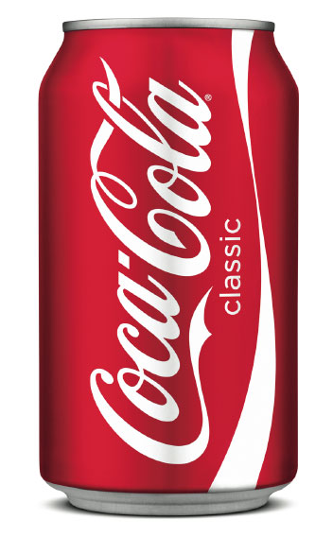
Conventional Can
It has a body diameter of 63mm, a height of 115.2mm.
New Sleek Can
It has a height of 145mm.
Both cans hold a volume of 330ml of cola.
We shall ignore the tapering towards the ends.

Slide 3
What are the upper and lower bounds for the capacity of the conventional can?
Assuming the two capacities are equal:
What are the upper and lower bounds for the diameter of the sleek can?
What is the upper and lower bound for the surface area of the original can?
What are the upper and lower bounds for the percentage of the original can which is empty if the contents are marked as 330ml?
diameter of 63mm
height of 115.2mm
height of 145mm

Slide 4
What are the upper and lower bounds for the capacity of the conventional can in cm³ to 1dp?
diameter of 63mm
height of 115.2mm

Slide 5
Assuming the two capacities are equal:
What are the upper and lower bounds for the diameter of the sleek can in cm to 2dp?
diameter of 63mm
height of 115.2mm
height of 145mm

Slide 6
What is the upper and lower bound for the surface area of the original can in cm² to 2dp?
diameter of 63mm
height of 115.2mm

Slide 7
What are the upper and lower bounds for the percentage of the original can which is empty to 2dp?
diameter of 63mm
height of 115.2mm

